Slide 1






Azin Vahanian Harshal Vaza Garima Sharma Yichen Yao
BANA 273: Final Group Project
Machine Learning

Slide 2
Agenda
Intro
Data Processing
Analysis
Implications
Q & A

Slide 3
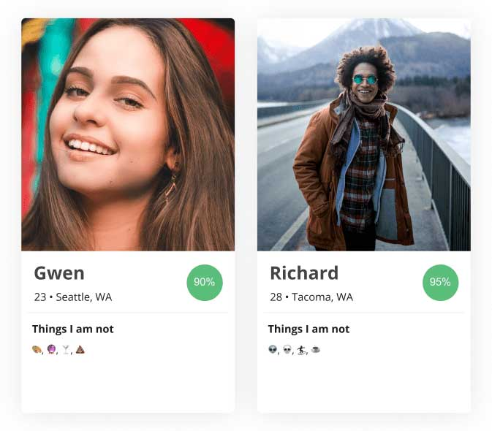
Intro
Data Processing
Analysis
Implications
Q & A
❥ People want to make a connection with someone
❥ Users create a profile and answer a series of categorical questions
❥ Matches people based on their age, hobbies, habits and lifestyle

Slide 4











Intro
Data Processing
Analysis
Implications
Q & A
Data Profile
-59,946 rows
-DataSource: Kaggle
-Mostly Categorical
-User inputted data
Education
Income
Drink
Location
# of Offspring
Ethnicity
Smoke
Height
Body Type

Slide 5

Intro
Data Processing
Analysis
Implications
Q & A
Data Profile
-59,946 rows
-DataSource: Kaggle
-Mostly Categorical
-User inputted data
Education
Income
Drink
Location
# of Offspring
Ethnicity
Smoke
Height
Body Type

Slide 6
Goal
Can the general habits and demographics of users be a good predictor of their body type?

Slide 7








Intro
Data Processing
Analysis
Implications
Q & A
Data Cleaning
Software:
Packages:
-Extracting, Converting,
and Categorizing the dataset
-Removing columns with high missing data
-Cleaning, grouping, and treating values

Slide 8
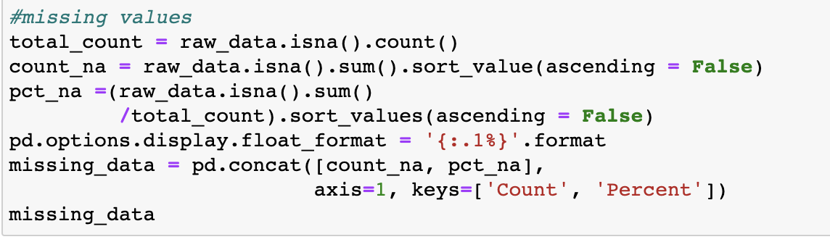
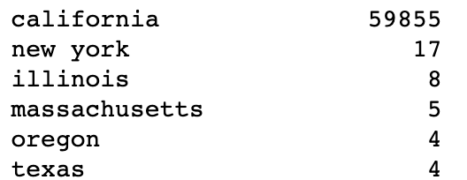
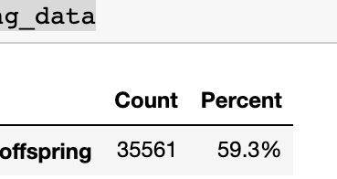

Intro
Data Processing
Analysis
Implications
Q & A
Number of Offspring
Location
-Almost 60% of this data was missing
-All of the data collected in one source
-San Francisco, California
Therefore: Some columns were removed included in the model

Slide 9
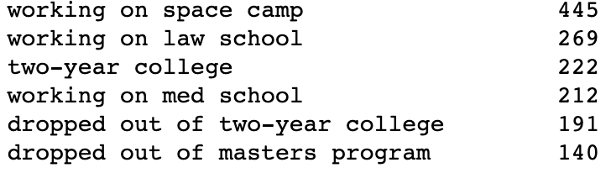
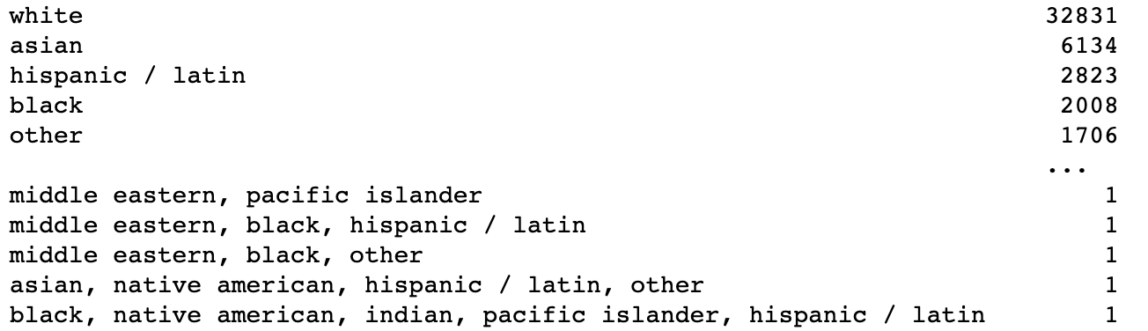
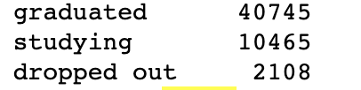

Intro
Data Processing
Analysis
Implications
Q & A
Education
Ethnicity
-32 options for education
-Consolidated into “Graduated”, “Studying”, ”Dropped out”
- 217 different entries
- Combination of different ethnicities
- Took the first value, most representative
-Consolidated to 6 options
Therefore: Consolidating and treating variables will help improve the model

Slide 10
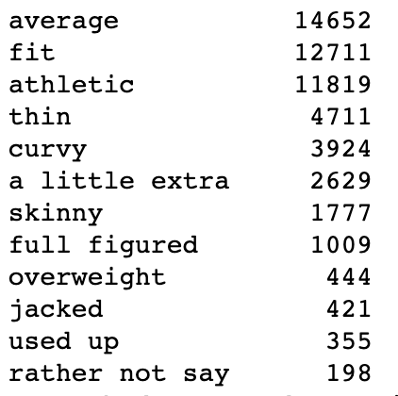
Intro
Data Processing
Analysis
Implications
Q & A
Class Variable
Fit
Overweight
Thin

Slide 11

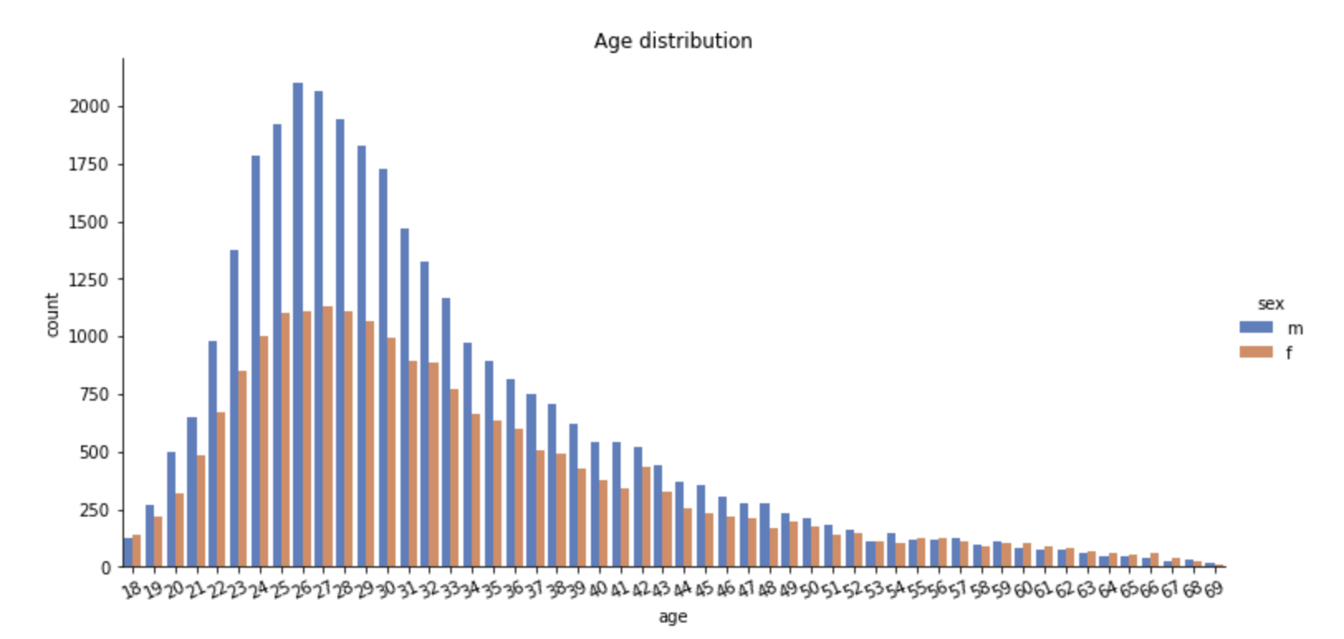


Intro
Data Processing
Analysis
Implications
Q & A
Data Visualization

Slide 12
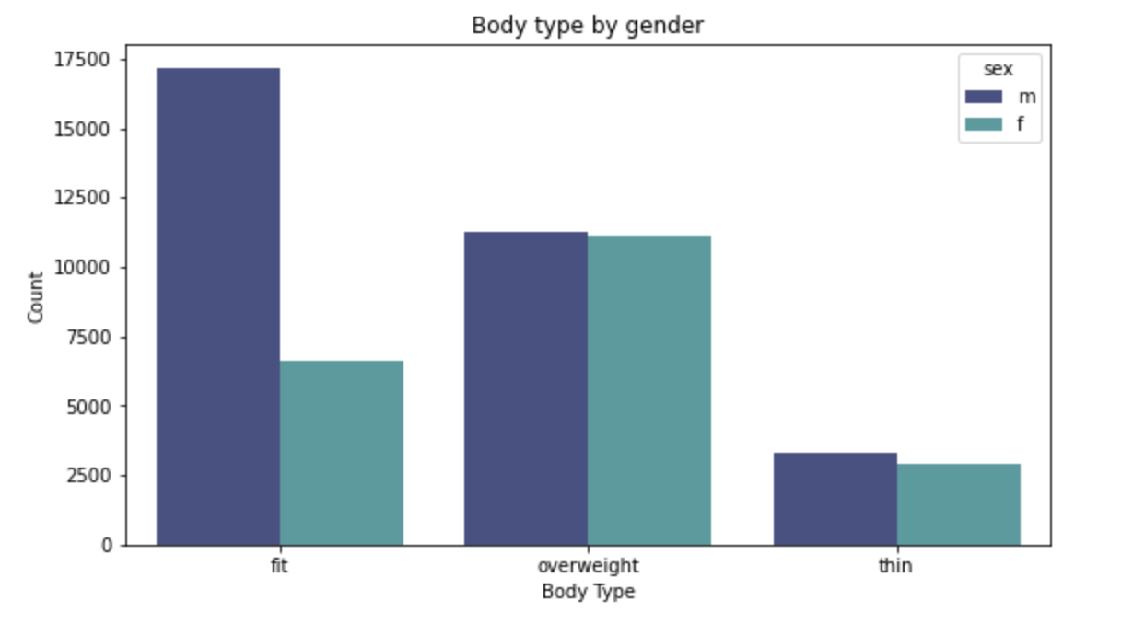
Intro
Data Processing
Analysis
Implications
Q & A
Data Visualization

Slide 13

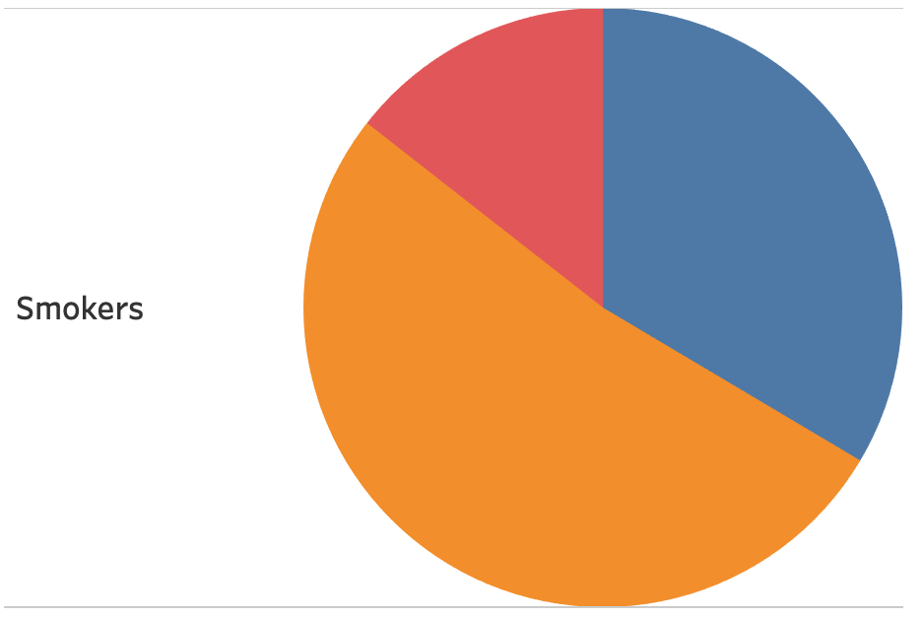

Intro
Data Processing
Analysis
Implications
Q & A
Data Visualization
Thin
14.4%
Users that are smokers also mark overweight over half the time
Fit
33.5%
Overweight
52.1%

Slide 14

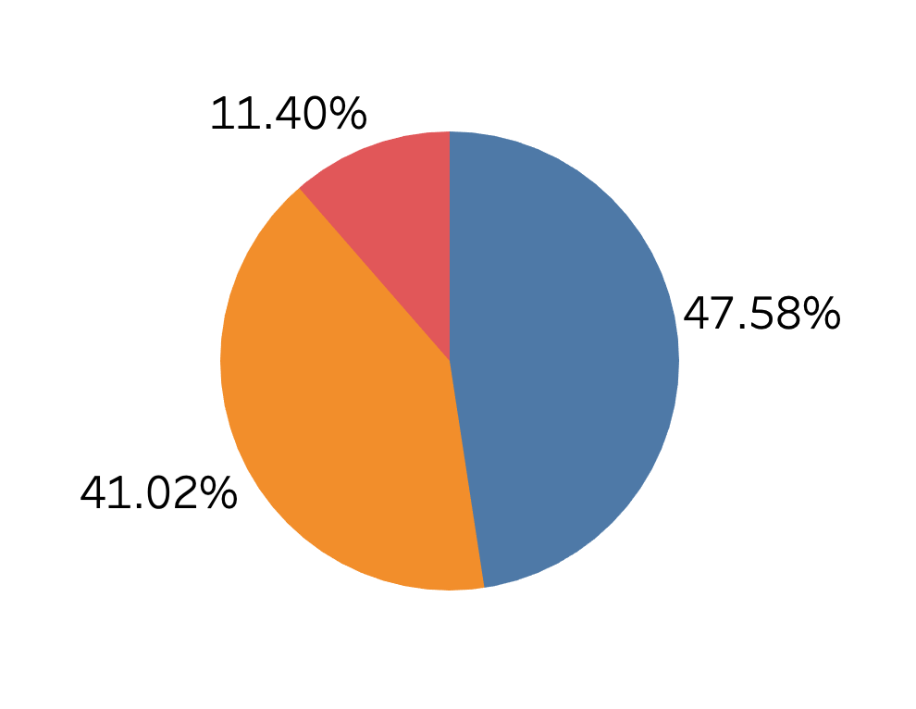
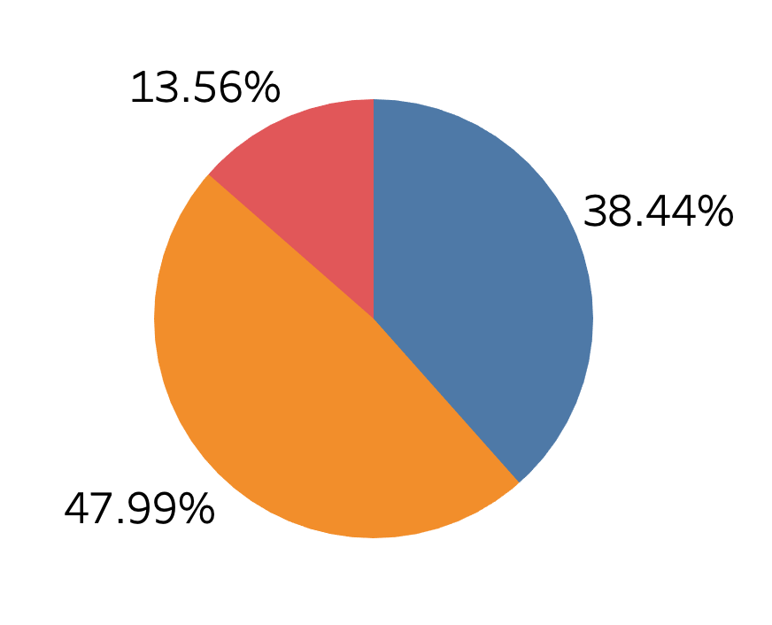
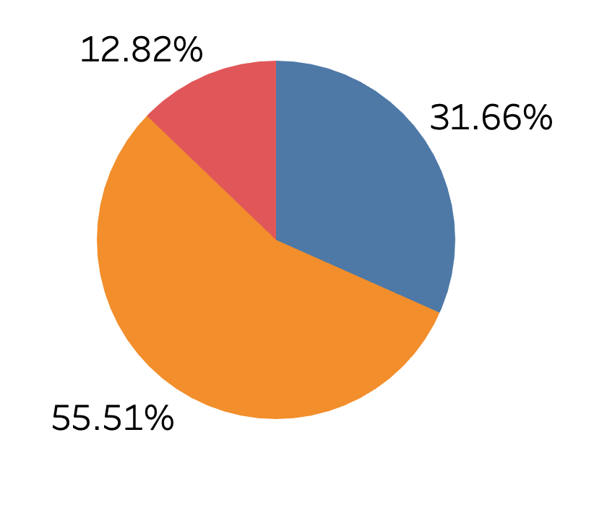
Intro
Data Processing
Analysis
Implications
Q & A
Education
Graduated
Studying
Dropped Out
Overweight
Thin
Fit
Increase in proportion of overweight as education level decreases

Slide 15


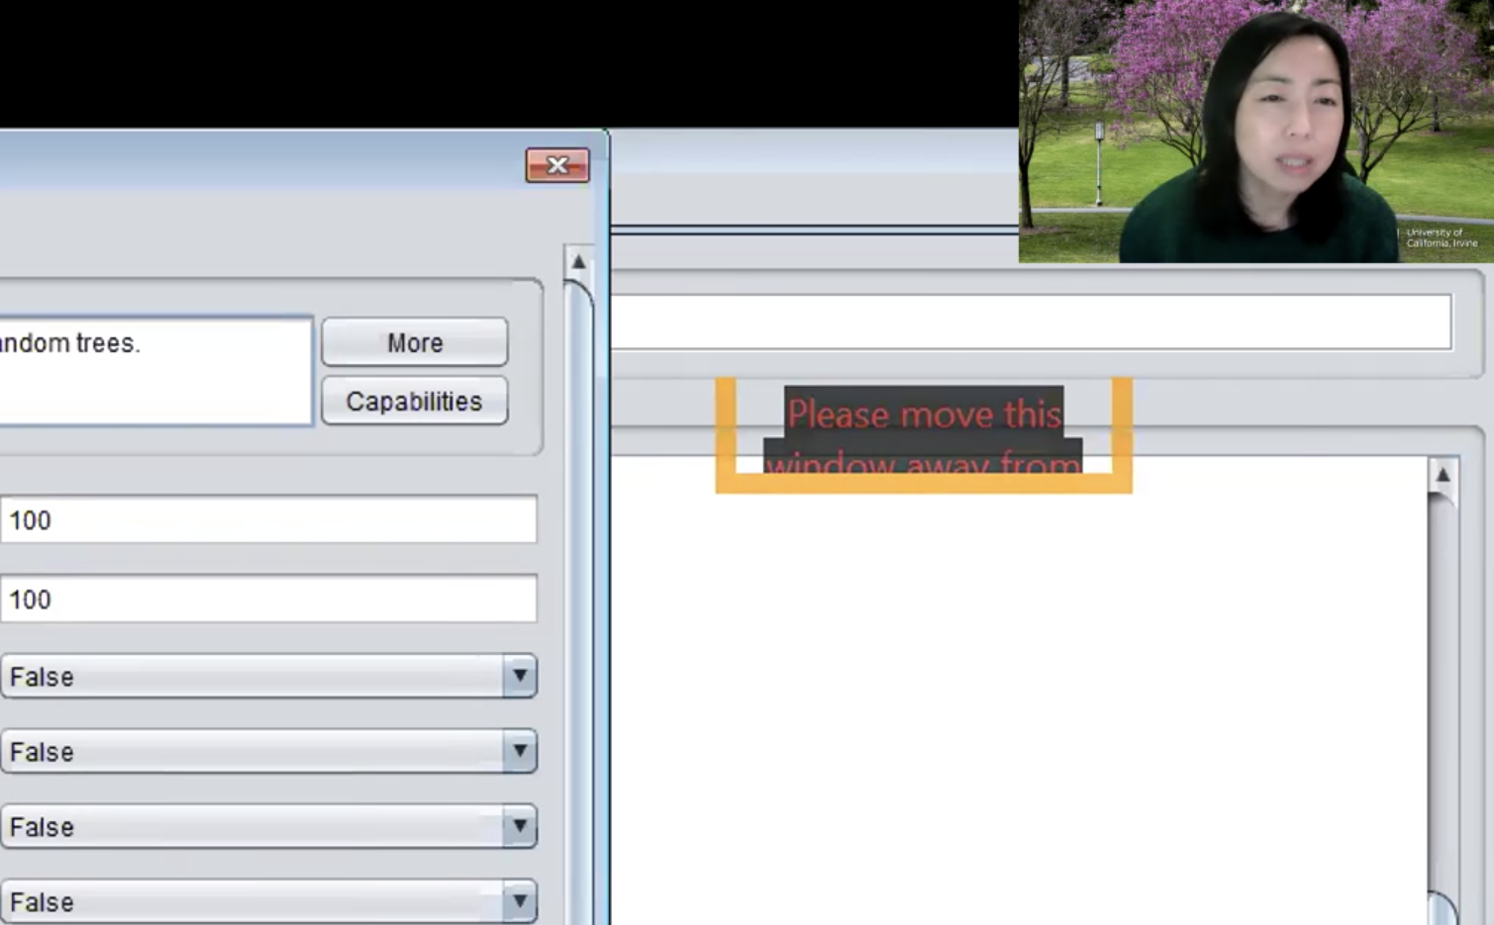

80% Training
20% Test
Intro
Data Processing
Analysis
Implications
Q & A
Spliting the Data
Use data to create model
41,854 Rows
Testing model accuracy
10,464 Rows

Slide 16

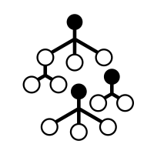
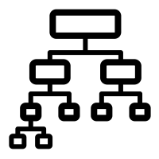
Decision Tree, KNN, and Random forest
Analysis
Decision Tree
K Nearest Neighbors
Random Forest
Accuracy = 55.26%
Best Depth = 7
Accuracy = 54.26%
Nearest Neighbors equal to 88
Accuracy = 50.44%

Slide 17
Decision Tree: Best Accuracy
Analysis
Decision Tree
K Nearest Neighbors
Random Forest
Accuracy = 55.26%
Best Depth = 7
Accuracy = 54.26%
Nearest Neighbors equal to 88
Accuracy = 55.43%

Slide 18


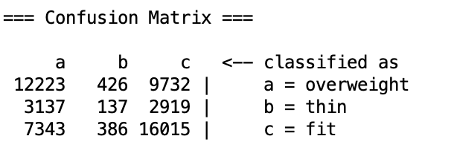
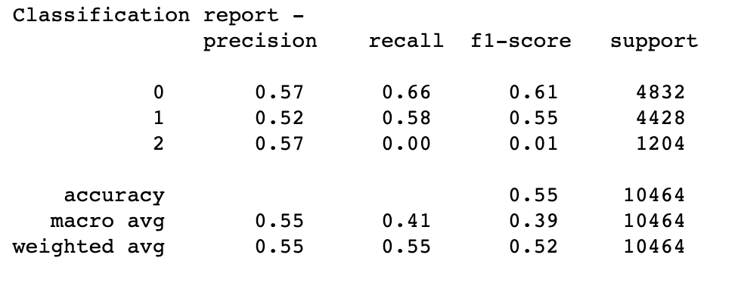
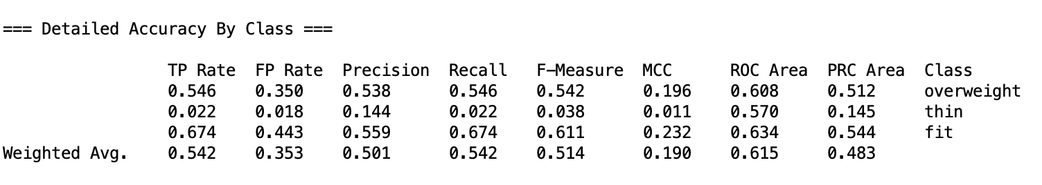
Decision Tree Python vs Weka
Analysis
Weka
80/20 Training and Test Split
10 fold cross validation

Slide 19

Top Variables Affecting Body Tpe
Intro
Data Processing
Analysis
Implications
Q & A
Sex
Smoke
Education

Slide 20
Implications
Intro
Data Processing
Analysis
Implications
Q & A
Improving the accuracy of the Machine Learning model
Making most entries mandatory
Include more variables that pertain to class variable
Different categorization/grouping of variables
Business implication
Bottom Line: improve matching algorithm
Use this model to accurately treat missing values
Less missing values, improved algorithm

Slide 21

Q&A
Q & A
Group 21

Slide 22


Software Used
Intro
Data Processing
Analysis
Implications
Takeaway
Microsoft PowerPoint
Microsoft Excel

